Slide 1
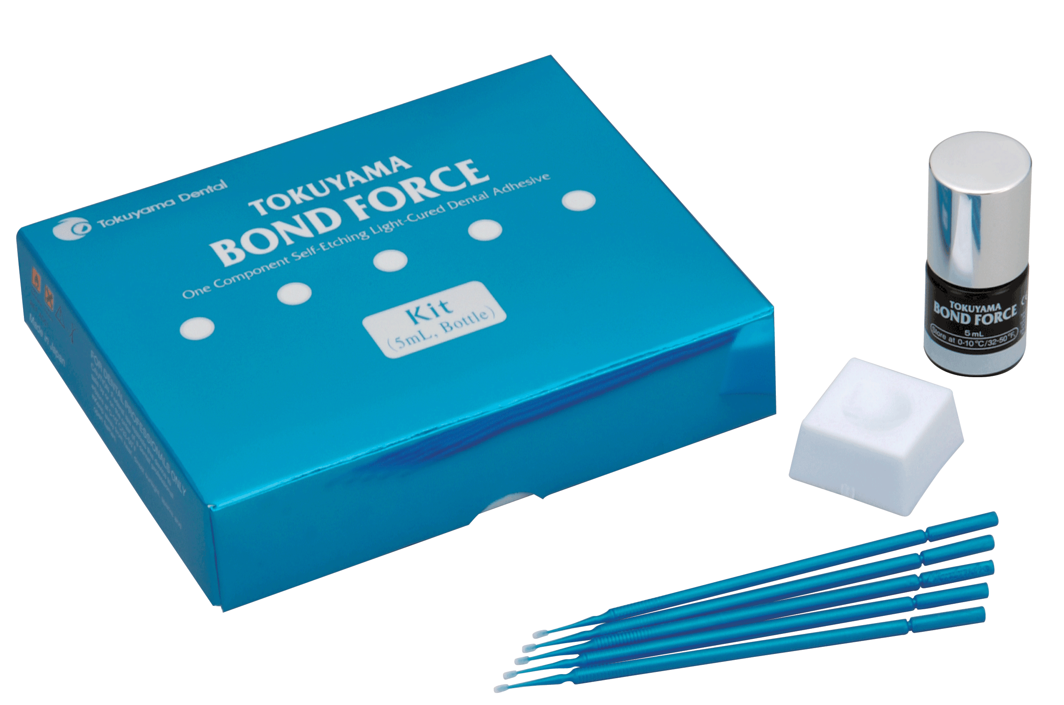
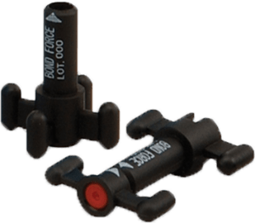
Bond Force®
by Tokuyama Dental America Inc.

Slide 2
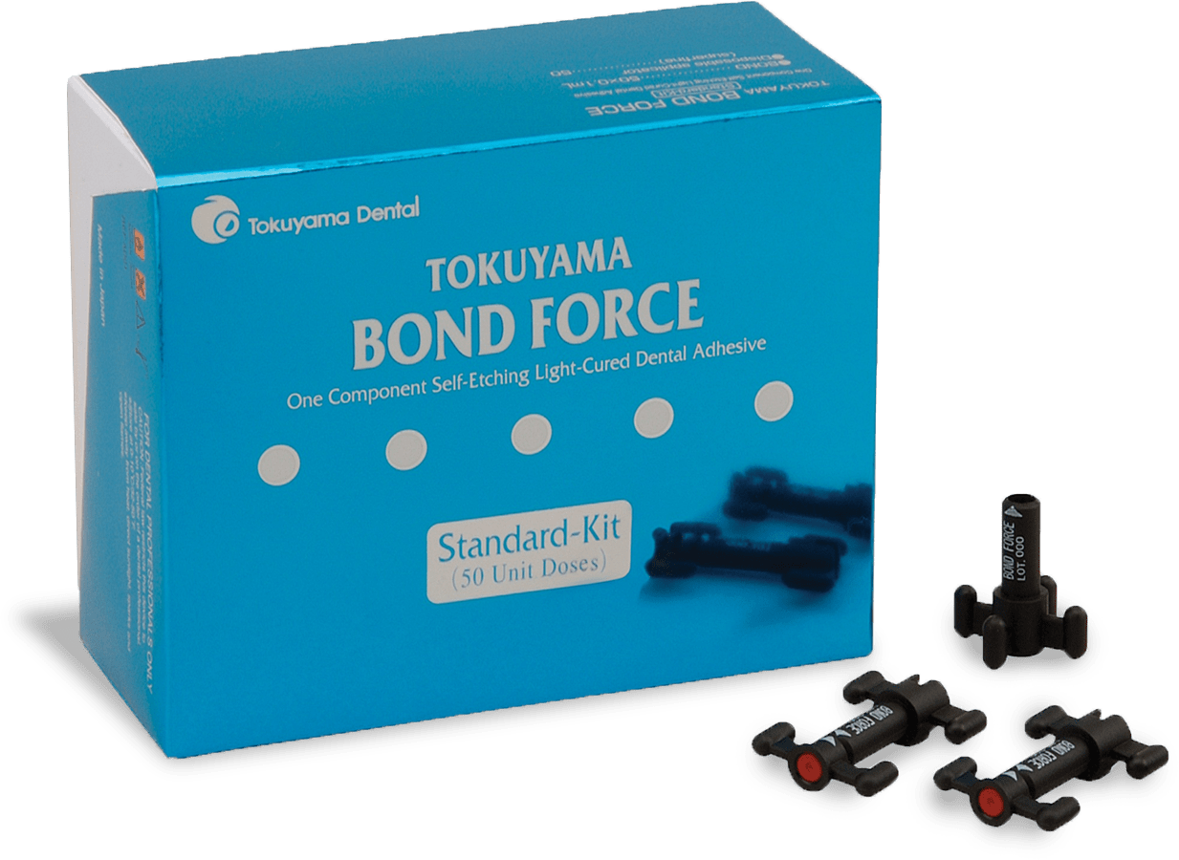
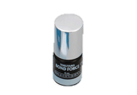
Seventh Generation Adhesive
Bond it right the first time, every time!
A seventh generation single component, self-etching, fluoride releasing bonding agent
Indications: Bonding of light or dual cured composite material to cut/uncut enamel and dentin and for fractured porcelain/ composite repair

Slide 3
Seventh Generation Adhesive
Simple to use
Apply, dry, cure
Easy application
Bottle
Unit Dose
Low film thickness
Low technique sensitivity -- moist, wet or dry
Excellent bond strengths to enamel and dentin
Reliability in one system

Slide 4
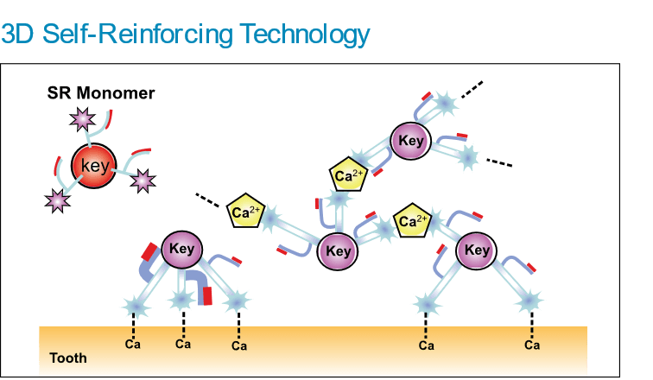
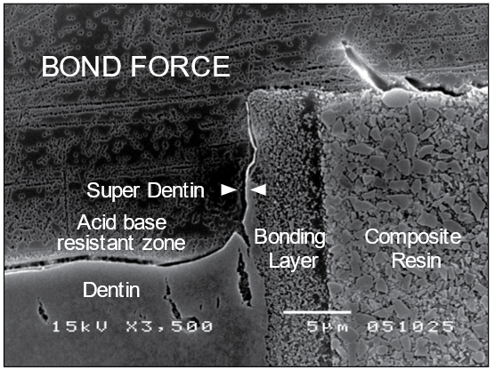
SR (Self-Reinforcing) Technology
The SR monomers cross-link to apatite on the tooth surface and calcium ions coming from tooth structure, these links form a strong bonding layer when light cured.
Forming Super Dentin
Fluoride releasing self-etching adhesive modifies the adjacent dentin, resulting in the secondary caries prevention. Acid-base resistant zones (Super Dentin) is observed under the hybrid layer of BOND FORCE.
Nikaido, et al.,
Tokyo Medical and Dental University
Jpn J Adhes Dent, 2007
X3.500

Slide 5
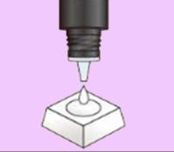
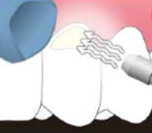
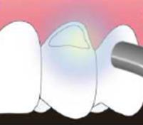
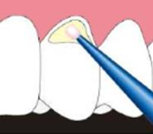
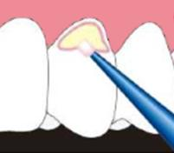
Simple
Apply
Dry
Cure
20 secs.
10 secs.
10 secs.
Dispense
Apply weak air for five seconds then strong air for five or more seconds
Light cure
Apply BOND FORCE
Rub the margins for 20 seconds

Slide 6
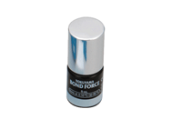
Simple
Bond Force® Bottle
Bond Force® Unit Dose
The traditional package for dispensing
5mL bottle
Easy, single, application
50 unit doses (0.1mL x 50)

Slide 7
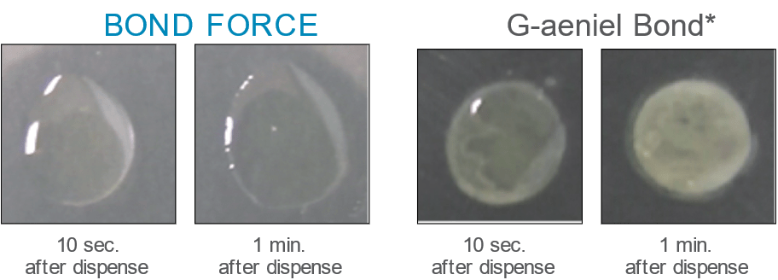
Working Procedure
Simple 1-step procedure
BOND FORCE satisfies all Etching, Priming, and Bonding procedures with 1-STEP. The Quick and simple bonding system is particularly beneficial for pediatric patients.
Only 1-application required
BOND FORCE does NOT require additional applications.
Plenty of working time
BOND FORCE remains stable for 5 minutes after dispensing without phase separation.
Etching, Priming, and Bonding in one application without mixing
No multiple applications

Slide 8
Less Post-Operative Sensitivity
In a self-etch system, etching and penetration of the bonding agent are processed at the same time; therefore, a gap (decalcified dentin without penetration of bonding agent) between the bonding layer and the dentin structure will not occur. This is one key advantage of a self-etch system. With a self-etch system, strong adhesion and durability to dentin is ensured and the risk of post operative sensitivity is minimized.
Post Operative Sensitivity Clinical Research in
24 months (2 years) 22 cases monitored
Source: Professor Jean-Pierre Attal, University of Paris V
DENTAL MATERIALS 27 (2011) 304-312

Slide 9
Technique
Bond Force® is not technique sensitive -- in fact, tooth desiccation provides the highest bond strength
Effect of Tooth Surface Moisture (Enamel)
25
20
15
Tensile Bond Strength/MPa
10
5
0
Tri S Bond
Bond Force®
G-Bond
XenoIV
iBond
OptiBond All-In-One
■ Dry ■ Moist ■ Wet
Moisture: Damp tooth surface (left to stand for 1 hour at 37˚C at 100% humidity); Wet: Tooth surface with water droplets
Tested in these conditions; Dry: Air-dried tooth surface

Slide 10
Bond Strength
Testing revealed Bond Force® provides benefits where others fail
Tokuyama Bond Force®
A uniform thin bonding layer was formed even around the corner and the edge of the cavity adaptation
The bonding layer is combined with both resin composite and the cavity wall remarkably, since no gaps can be observed at the interface
Bonding Layer (12.8um)
Resin Composite
Dentin
Easy Bond (3M ESPE)
G-aeniel Bond (GC)
Single Bond Plus (3M ESPE)
①
Bonding Layer
Bonding Layer
Bonding Layer
②
③
④
Composite Resin
Composite Resin
Composite Resin
Dentin
②
Dentin
③
④
Dentin
The bonding layer using Easy Bond became thick and pooled around the corners of the preparation
Voids appeared between the bonding layer and composite resin
The bonding layer of G-aenial Bond is full of porosity around the corners of the preparation
Voids appeared between the bonding layer and composite resin
The bonding layer became thick and pooled around the corners of the preparation
There was slight abrasion that was observed in the bonding layer after being polished

Slide 11
Tokuyama’s Bond Force® provides incomparable strength
Micro Tensile Bond Strength (Mpa)
Adhesive
Bond Force®
AdheSE One
Brush & Bond
G-Bond
Tri-S Bond
Dentin
Uncut Enamel
Cut Enamel

Slide 12
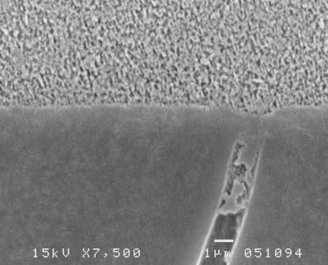
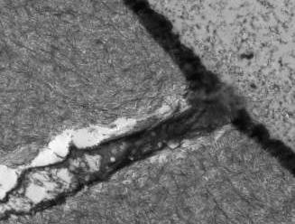
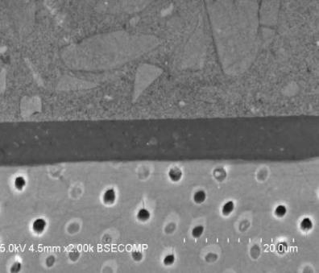
Film Thickness
Bond Force®’s thin, tough Hybrid Layer creates a strong adhesion to dentin
×2000
BOND FORCE
BOND FORCE
8μm
Dentin
20μm
50μm Resin Tag Penetration
0.2-0.5μm Resin-Dentin Hybrid Layer
Film Thickness
Case courtesy: Prof. Tagami, Tokyo Medical and Dental University

Slide 13
Enhance Your Practice with Tokuyama’s Bond Force®
Faster, easier, stronger
Simple to use
Not technique sensitive (Works great under any surface moisture conditions)
Incomparable strength
All in one delivery system

