Slide 1

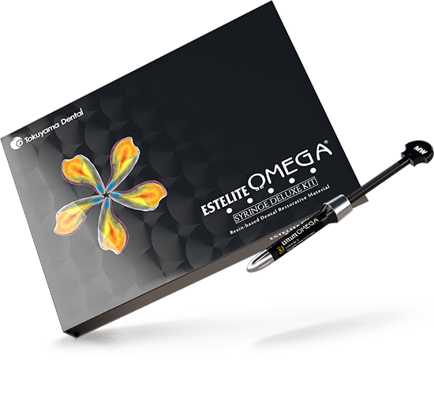
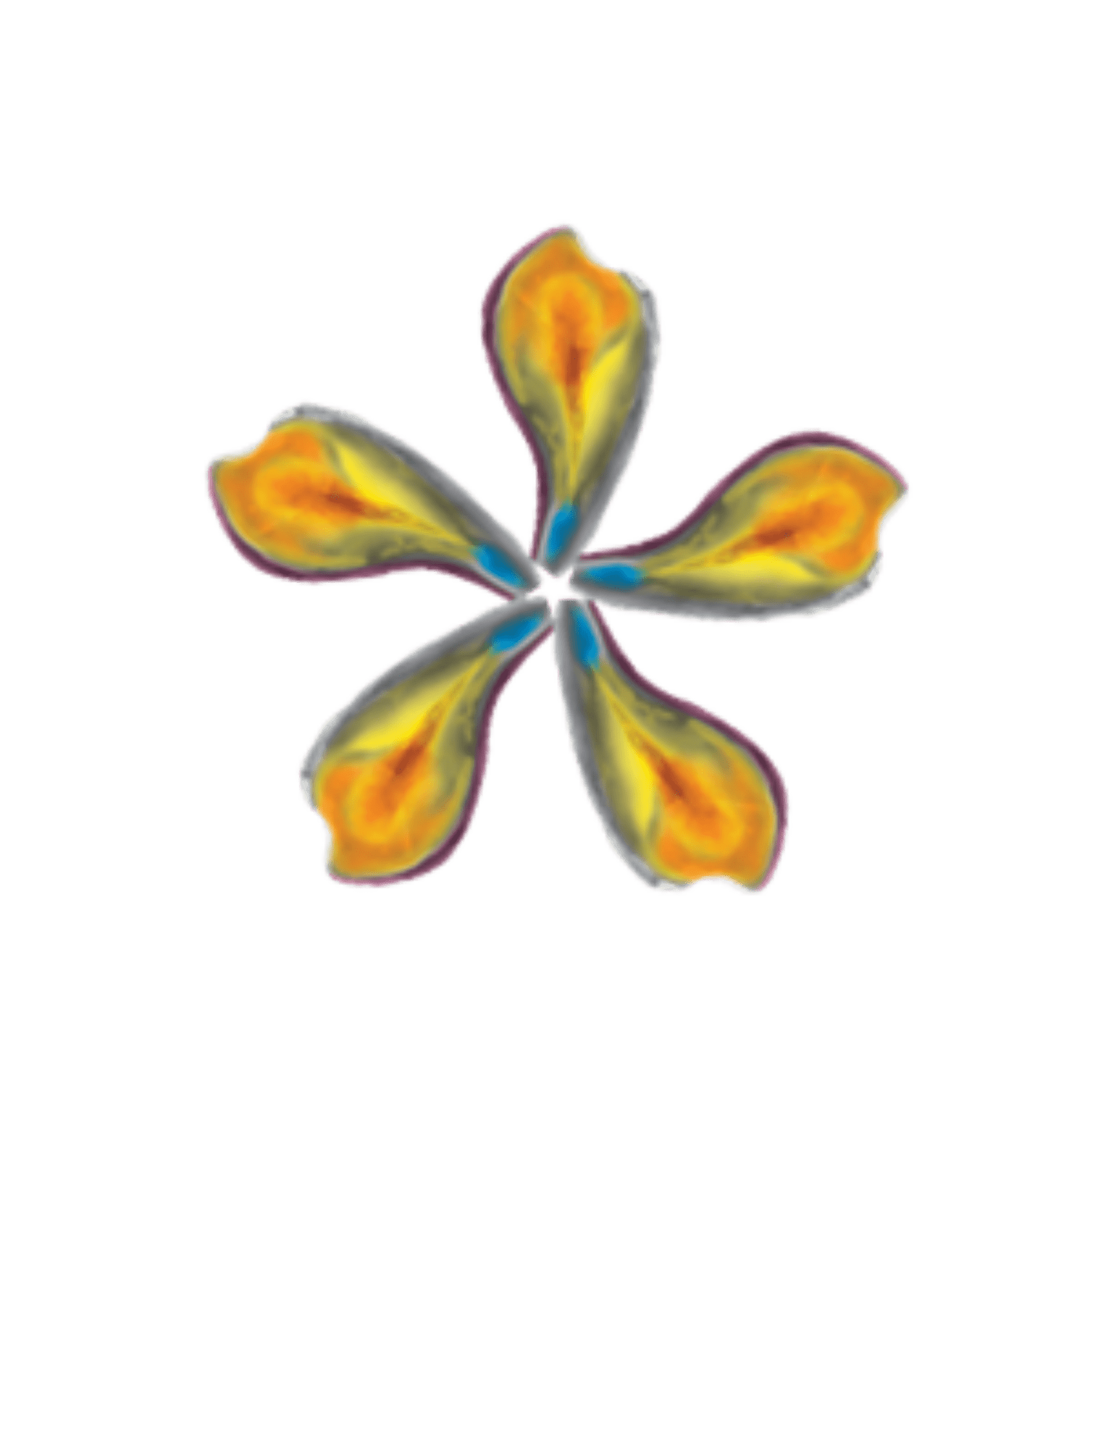
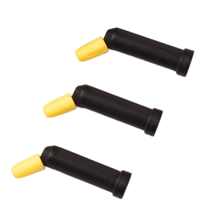

Unlock Premium Capabilities
Notes:
Today I’m going to be talking to you all about ESTELITE OMEGA, our premium polychromatic universal composite system

Slide 2
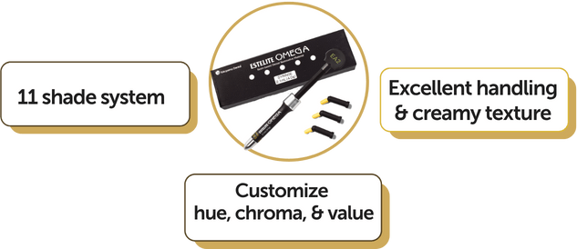

For the artist seeking perfection
Developed & collaborated with
Dr. Newton Fahl, Jr., D.D.S., M.S.
ESTELITE OMEGA is a premium polychromatic universal composite system that elevates dentistry to artistic masterpieces.
MCG-Hinman Foundation fellow
2008 President´s Award for Best Teacher (American Academy of Esthetic Dentistry)
2011 Excellence in Cosmetic Dental Education (Award American Academy of Cosmetic Dentistry)
Author of the book Composite Resin Veneers – The Direct-Indirect Technique (2020)
Director of the Fahl Center, in Curitiba, Brazil
Notes:
ESTELITE OMEGA was developed in collaboration with Dr. Newton Fahl, a respected expert in esthetic dentistry. As I mentioned, it is a premium polychromatic universal composite system that was designed to elevate dentistry to artistic masterpieces.
It has a simplified 11 shade system that allows you to customize hue, chroma & value on each individual tooth!
Now lets see what makes this composite system so exceptional

Slide 3
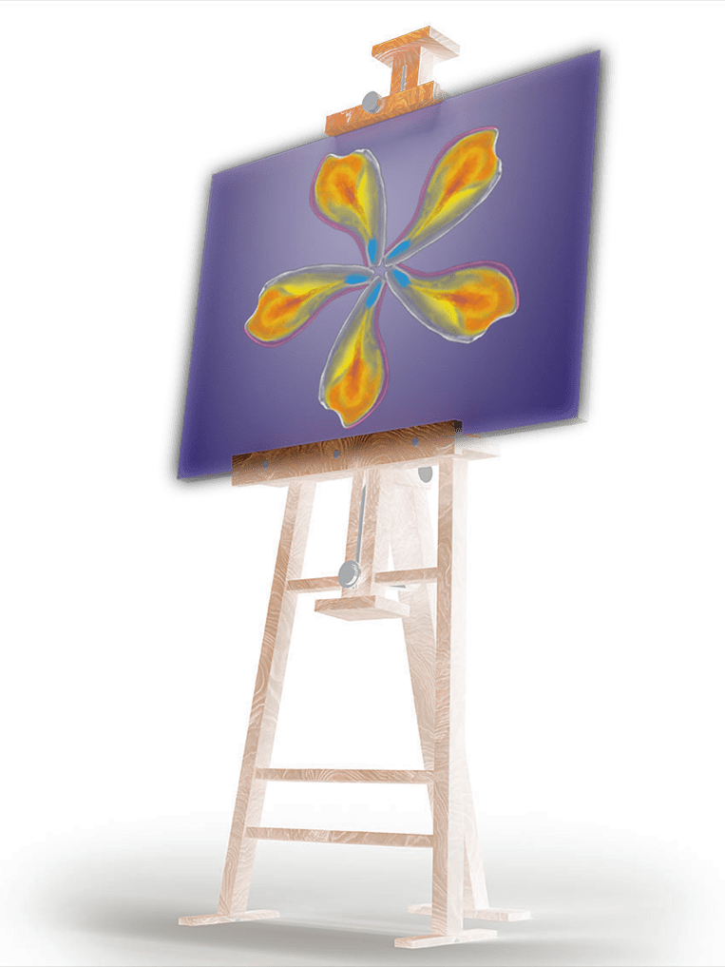
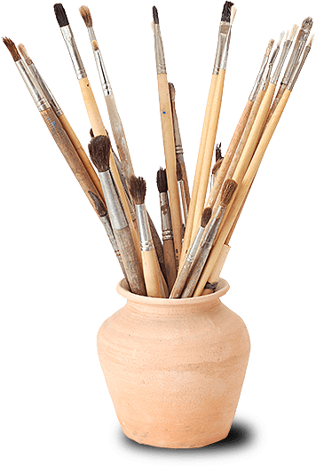
Simple & Excellent
Indicated for:
Anterior and Posterior Restorations
Composite Veneer
Diastema Closure
Composite / Porcelain Repair
Features & Benefits
Superb Esthetics
Excellent Polishability
Long-Lasting Gloss Retention
High Flexural & Compressive Strength
Notes:
ESTELITE OMEGA is a highly esthetic yet versatile composite.
Can be used in the Anterior as well as the Posterior and is ideal for veneers, diastema closures, and porcelain repairs
It’s superb esthetics & long-lasting gloss retention help make your restorations naturally esthetic
And of course, it has high flexural and compressive strength ensuring beautiful yet also highly durable restorations.

Slide 4
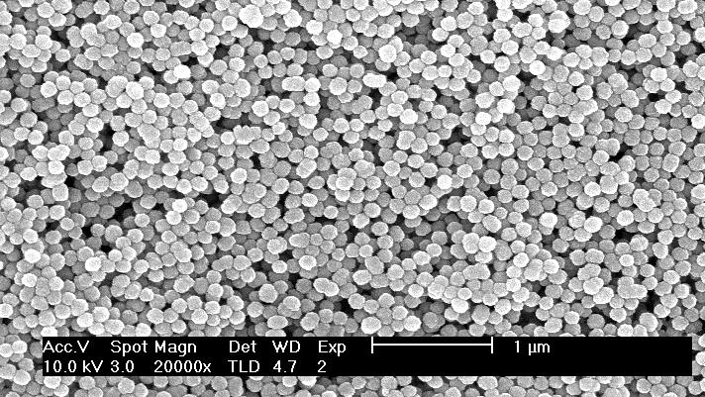
A 100% spherically filled supra-nano composite for esthetic restorations
Simple
Beautiful
Lasting
Efficient superior shade blend
One shade may integrate with up to 10 shades, reducing inventory costs
No shade shift for predictable before and after curing
Exceptional handling properties for ease of use
High diffusion for a superb blend with surrounding teeth
Extreme resistance to slump, for anatomical creation at your pace
High gloss for initial and long-term polish retention
Enduring stability without harming opposing teeth
Low 1.3% volumetric shrinkage to resist marginal leakage
Low shrinkage stress for lasting patient comfort
Retained levels of surface smoothness and reduced abrasion for long-term wear resistance
Notes:
It’s Simple: While there are 11 shades to choose from, one shade can blend across up to ten natural shades, reducing inventory costs and the need to stock up on a million different shades
It’s Beautiful: OMEGA has exceptional shade diffusion for seamless blending as well as extreme resistance to slump, giving you the ability to shape and create at your own pace.
It’s Long Lasting: It’s low volumetric shrinkage (1.3%) and low shrinkage stress ensures patient comfort and restoration longevity.
ESTELITE OMEGA was designed to perform at the highest level at every stage, from placement to years after!

Slide 5
The key to restorations that mimic the opalescence of natural teeth
Hue (color)
Chroma
Value
A color that reflects
off an object
Saturation of the hue
The brightness
or darkness of color
Notes:
Now lets talk about the science behind the color:
They key to mimicking the opalescence of natural teeth color lies in Hue (the color that reflects off an object), Chroma (saturation of the hue) & Value (the brightness or darkness of color)
These elements are what help layer the composite to perfection.

Slide 6
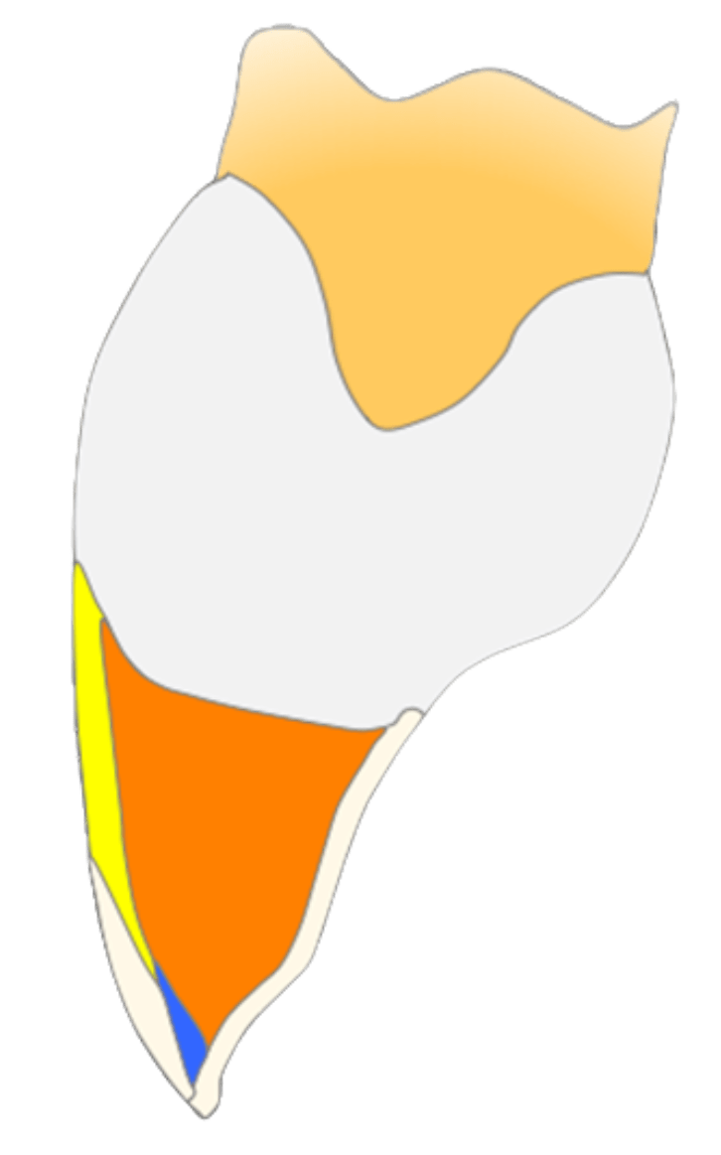
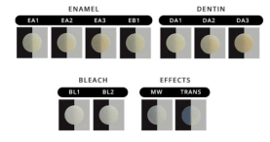
ESTELITE OMEGA Shade Palette
Body Enamel
Enamel A1
EA1
Enamel A2
EA2
Dentin
Enamel A3
EA3
Body
Enamel
Enamel B1
EB1
Milky-White
Effect Translucent Enamel
Trans
Trans
Trans
Bleach
Effect Semi-Translucent Enamel
Milky White
MW
Dentin
Dentin A1
DA1
Dentin A2
DA2
Dentin A3
DA3
Bleach
Bleach 1
BL1
Bleach 2
BL2
Layering will enable you to create a perfect restoration
Notes:
Now lets look at those layers
ESTELITE OMEGA’s shade palette include Body Enamel, Translucent Enamel Effects, Dentin, & Bleach shades.
By combining these shades, layer by layer, you can create the depth & realism necessary to emulate natural looking restorations.

Slide 7
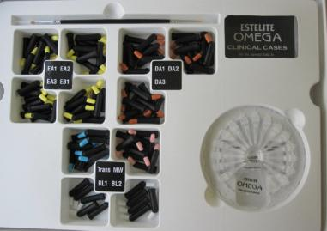
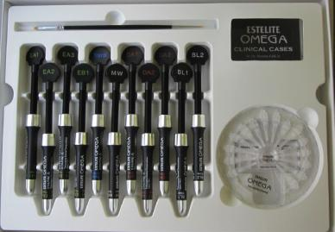
Delivery Form (Deluxe Kit)
11 shades
100 PLTs (0.25g each)
11 shades
11 Syringes (4g each)
Notes:
ESTELITE OMEGA can be purchased as what we call, a Deluxe Kit, in syringe or PLT forms.
Or as individual refills, as you’ll see in the next slide

Slide 8
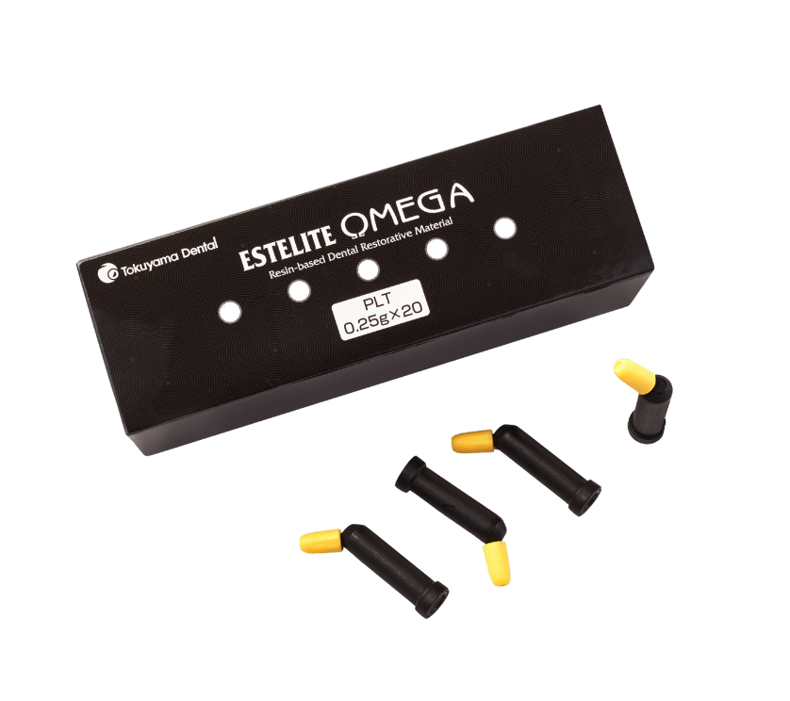
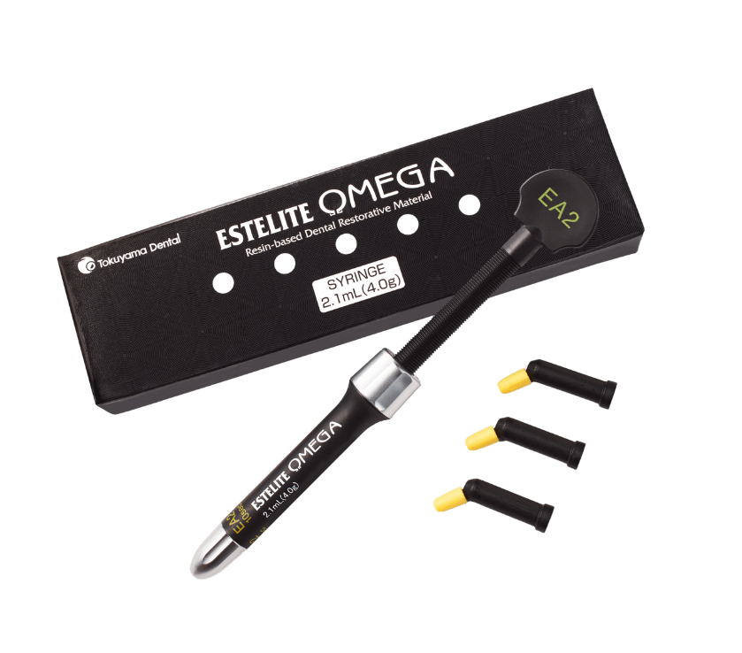
Delivery Form (Refill)
PLTs (20x0.25gm)
Syringes (4g)

Slide 9
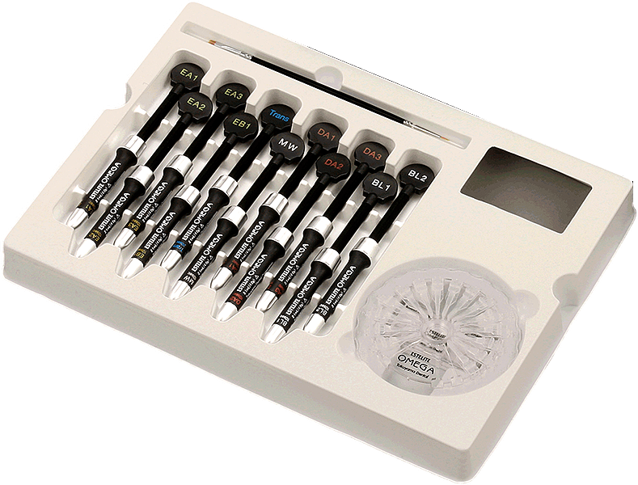
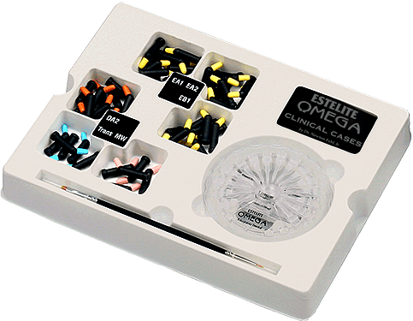
With a tooth as your canvas, we provide you with one simple kit to create with
What’s in your Deluxe Kit?
  11 Shades (PLT or Syringe)
  Custom Shade Guide - x 1
  Brush - x 1
  Clinical Cases (QR Code) x 1
  Restorative Technique Card - x 1
  Instruction – x 1
Notes:
So what comes in your deluxe kit:
You will receive all 11 shades
A custom shade guide that we will talk more about in the next slide
A sable brush
A QR Code that grants you access to a library of guided clinical cases
A technique card
And lastly some instructions

Slide 10
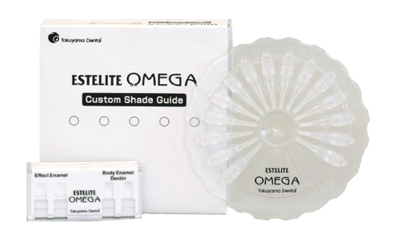
ESTELITE OMEGA Custom Shade Guide
Custom-made by you, personalize it to contain only the shades you use
Versatile, all-in-one system
Works with any brand of composite system
Organized and personalized: Organize your shade guide for your own chair-side convenience
Most accurate shade matching made from the same composite used in patient's mouth
Notes:
Here is the custom shade guide I mentioned.
This tool allows you to create your own personalized shade guide using actual ESTELITE OMEGA composite so you will never have to guess how A2 your A2 will be

Slide 11
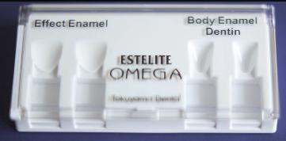
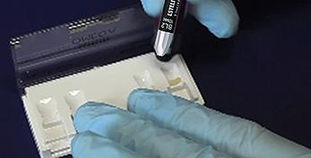

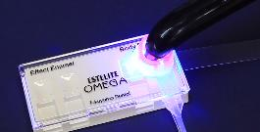
Perfection Without Guessing
Tooth Mold
Fill with Composite
Insert Handle
Light Cure
Notes:
It’s simple to use, just fill the tooth mold with the composite, insert the handle, & light cure

Slide 12
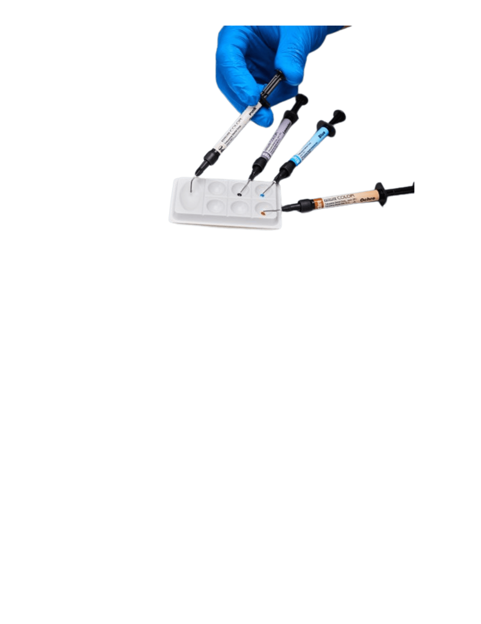
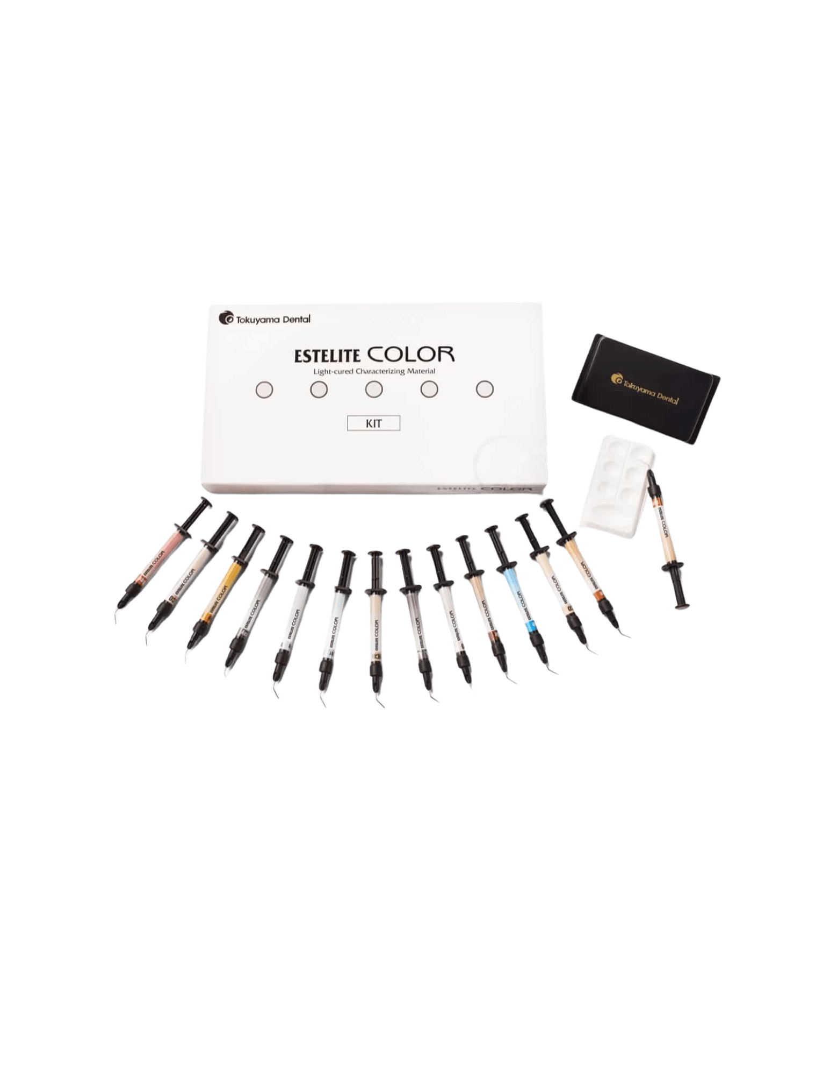
Advance Your Creative Touch with:
ESTELITE Color
Available in 13 colors, ESTELITE Color is a resin based, light-cured tint for individualized shade characterizations of direct and indirect resin restorations.
Can be applied below or in-between the layers of the dental composite restoration to help perfect the overall esthetics of your masterpiece.
9 Tints: Blue, Brown, Clear, Gray, Lavender, Ochre, Red, White & Yellow.
4 Opaquers: Low Chroma Opaque, Medium Chroma Opaque, High Chroma Opaque & Pink Opaque
Available as a kit or individual refills
Notes:
Now lets take our artistry even further with ESELITE COLOR
ESTELITE Color is a resin based, light cured tint for individualized shade characterizations.
It can be layered below or between the layers of composite to create natural effects like translucency or warmth
It is available in 13 colors: 9 tints & 4 opaquers
If they ask for more info on the colors:
Incisal edge: Blue (youthful look), Gray (mature look), Lavender (elderly look)
Increasing saturation: Ochre (fossae areas), Dark Brown (pits and fissures; stained craze lines)
White spots: White
Color adjustment: Yellow, Ochre, Red (mixed in varying proportions)
Chroma adjustment: Clear (mixed with another shade)
Neutralizing grayness: Pink Opaque (mixed with LCO, MCO, or HCO) Tints can be mixed in varying proportions to achieve the correct hue, value and chroma, as needed. Opaquers can be mixed in varying proportions to achieve the correct value and chroma, as needed.

Slide 13
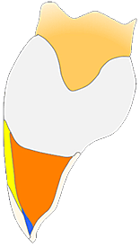
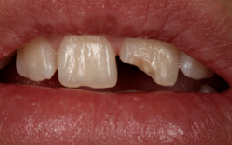
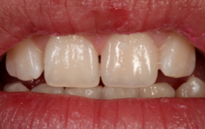
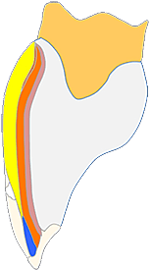
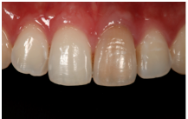
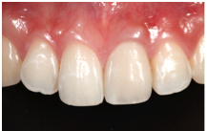
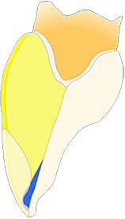
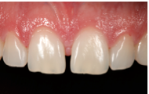
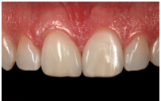
Challenging cases featuring ESTELITE Omega
Before
After
Class IV
Direct Veneer
Diastema Closure
Cases Performed by: Dr. Newton Fahl, Jr., D.D.S., M.S.
Notes:
Now I’d like to show you all some before and after images showcasing real clinical success using ESTELITE OMEGA in some challenging cases
You can see how the restorations are not only highly esthetic, but also completely natural looking in shade as well as texture.

Slide 14








More challenging cases featuring ESTELITE Omega
Before
After
Class IV Fracture on #8, restored with two-layers
Performed by: Dr. Rodrigo R. Maia, DDS. MS. Ph.D,
and Dr. Sandra Guzmán-Armstrong, DDS, MS
Diastema Closure on #8 and #9, and mesial/distal on #7 and #10
Performed by: Dr. Jonathan Adams, DDS
Large Class IV Fracture on
tooth #9
Performed by: Edward M. Narcisi, D.M.D.
Class IV Fracture on #9, textured to match natural anatomy using Estelite Omega
Performed by: Dr. Robert Antmann, DDS
Notes:
Here are some more case images.

Slide 15

Scan QR Code for More Info or Place Order
Notes:
Thank you so much for listening to me today, if you have any questions for me I’d be happy to answer them
Or if you feel you’re ready elevate your dentistry with ESTELITE OMEGA, we do sell through all major dealers. (I can also answer any dealer questions you may have)

